Slide 1








MENTORNESS PROJECT
MARKET PRICE PREDICTION
LEKSHMI L

Slide 2
CONTENTS
DATASET ANALYSIS
DATA PREPROCESSING
EXPLORATORY DATA ANALYSIS
FEATURE ENGINEERING
MODEL TRAINING
MODEL EVALUATION

Slide 3



DATASET ANALYSIS
Objective: Develop a robust time series machine learning model capable of accurately forecasting market trends based on historical data.
• market: The market or commodity under consideration.
• month: The month for which the data is recorded.
• year: The year corresponding to the recorded data.
• quantity: The quantity of the commodity traded or available.
• priceMin: The minimum price of the commodity during the month.
• priceMax: The maximum price of the commodity during the month.
• priceMod: The mode or most frequently occurring price of the commodity during the month.
• state: The state or region where the market is located.
• city: The city where the market is situated.
• date: The specific date of the recorded data.

Slide 4
DATA PREPROCESSING
Handled missing values by dropping rows with missing entries.
Encoded categorical variables like market, state, and city using one-hot encoding. This creates separate binary features for each category.
Converted the 'date' column to datetime format and then extracted the year and month as separate features.
Numerical features (quantity, priceMin, priceMax, priceMod) using a StandardScaler. This helps ensure all features are on a similar scale before training a model.
Target variable as 'priceMod' and split the data into training and testing sets.

Slide 5

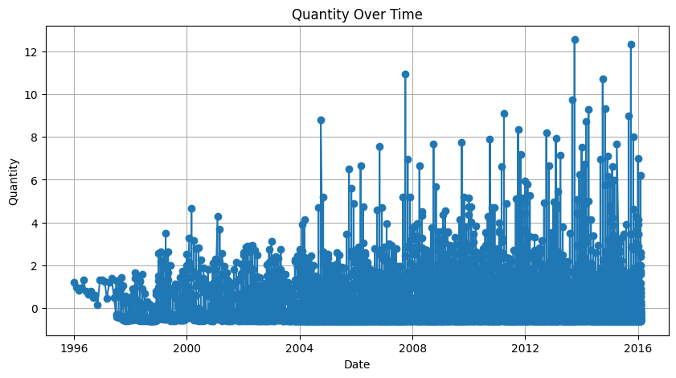
EXPLORATORY DATA ANALYSIS
The line slopes upwards from left to right, which indicates that the quantity is generally increasing
over time. There might be some fluctuations around the trend, but the overall pattern suggests an upward trajectory.

Slide 6
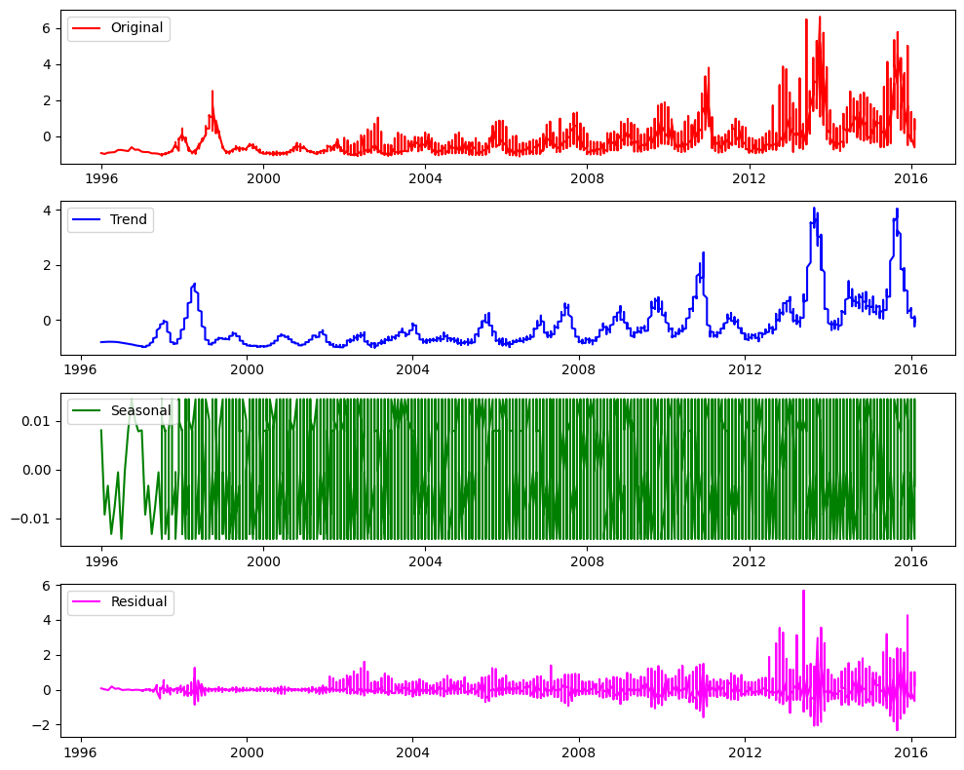
EXPLORATORY DATA ANALYSIS
Trend: It appears the price has an overall increasing trend over time.
Seasonal: There doesn't appear to be a strong seasonal component to the price in this case.
Residual: The residuals appear to be random fluctuations around zero, with no clear pattern.

Slide 7
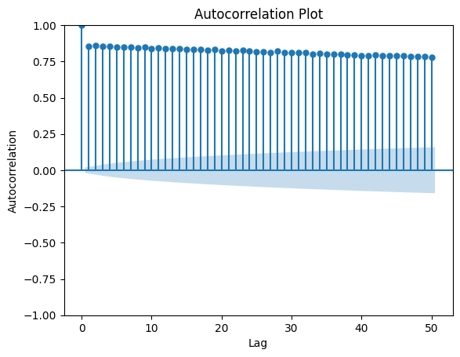
EXPLORATORY DATA ANALYSIS
plot likely showed values close to 0, suggesting no significant relationship between past and current prices. This can be helpful when choosing a time series forecasting model.

Slide 8
FEATURE ENGINEERING
For our market price prediction project, we have applied several feature engineering techniques to enhance our dataset.
1. Lagged Variables
Lagged variables are created to introduce past values of the time series as new features. This helps the model capture temporal dependencies.
2. Rolling Statistics
Rolling statistics, such as rolling mean and rolling standard deviation, are calculated to capture the moving average and variability over a specified window.

Slide 9
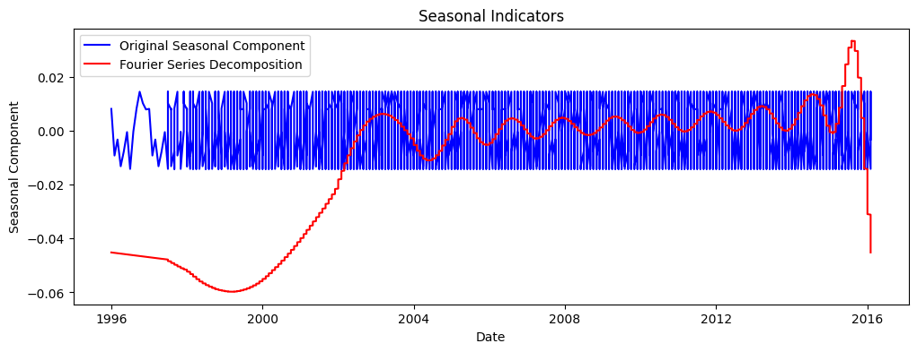
FEATURE ENGINEERING
The Fourier Series decomposition (red line) closely resembles the original seasonal component (blue line), suggesting the presence of subtle seasonality in the data.

Slide 10

MODEL TRAINING
2. ARIMA:
The ARIMA (AutoRegressive Integrated Moving Average) model is used for capturing linear patterns in time series data.
Trained using historical time series data to capture auto-regressive, differencing, and moving average components for forecasting.
1. SARIMA
The SARIMA (Seasonal ARIMA) model extends ARIMA by including seasonal components, making it suitable for data with seasonal patterns.
Trained on historical time series data, incorporating seasonal patterns to enhance forecasting accuracy.
3. Prophet:
Prophet, developed by Facebook, is a robust model designed for forecasting time series data that can handle missing data and outliers well.
Trained with historical time series data, using its flexibility to capture trends, seasonality for forecasting.

Slide 11
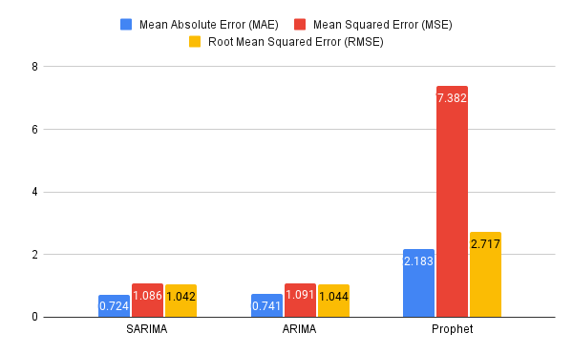
MODEL EVALUATION

Slide 12
THANK YOU

